Slide 1
Airline Customer Satisfaction Prediction Using Machine Learning
M.Sohaib 23L-2519
Abdullah Arshad 23L-2531
M.Awais 23L-2618

Slide 2
Problem Statement
The airline industry faces significant challenges in maintaining and improving customer satisfaction, a key factor in building loyalty and staying competitive.
Problem :
Passengers' satisfaction is influenced by factors like delays, service quality, seat comfort, and travel class, making prediction challenging. Existing methods struggle to analyze diverse datasets with both numerical and categorical features.
Solution :
Predict Satisfaction : Classify passengers as "Satisfied" or "Unsatisfied."
Identify Key Drivers : Highlight factors like in-flight services and delays to guide improvement efforts.

Slide 3
Dataset Information
Source:
Dataset obtained from a public repository containing passenger feedback and flight-related data from kaggle.
Dimensions (Features, Records etc):
Features: Includes 20 attributes (categorical and numerical).
Records: Approximately 129,000 rows of passenger data.
Class Distribution (If Classification):
Satisfied: ~44% of the data.
Unsatisfied: ~56% of the data.
Indicates a slight imbalance in the dataset.
Dataframe summary:
Categorical features: Customer Type, Gender, Class; Numerical features: Age, Flight Distance, Delays; missing values imputed with mean/mode, and numerical features standardized.

Slide 4
Data Preprocessing and Transformation
Before Data Preprocessing:
Issues Identified:
Missing values in some features.
Outliers in numerical attributes (e.g., age, flight distance).
Slight class imbalance in the target variable.
Categorical attributes (e.g., Gender, Customer Type) needed encoding.
Irrelevant features (e.g., Passenger ID) required removal.
Goal of Preprocessing:
Address missing values and outliers.
Encode categorical features for machine learning compatibility.
Balance the dataset and remove irrelevant features.

Slide 5
Data Preprocessing and Transformation
After Preprocessing and Transformation
Results of Preprocessing:
Missing Values: Imputed numerical values with mean and categorical values with mode.
Outliers: Detected using box plots and capped or removed for a uniform distribution.
Feature Scaling: Standardized numerical features (Age, Flight Distance, Delays) using Z-score normalization.
Encoding Categorical Features:
One-Hot Encoding for nominal variables (e.g., Gender, Class).
Label Encoding for ordinal variables (e.g., Satisfaction).
Feature Engineering: Created interaction variables (e.g., Flight Class × Delay Duration) and dropped irrelevant features like Passenger ID.

Slide 6
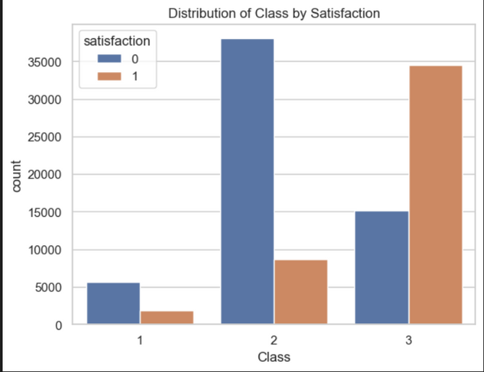
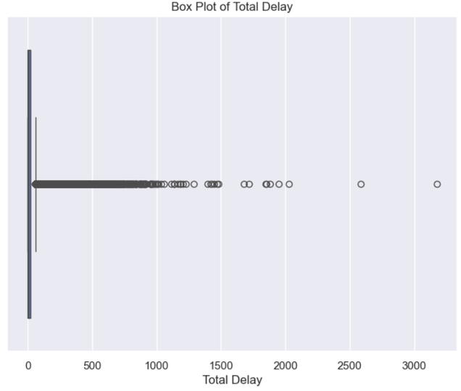
Exploration and Visualization
Bar Chart: Satisfaction by Flight Class
Highlights higher satisfaction among premium class passengers compared to economy class.
Clear trend: Satisfaction improves with flight class upgrades.
Box Plot: Delays vs. Satisfaction
Showcases how longer delays are strongly associated with dissatisfaction.
Key Insight: Reducing delays can significantly improve customer satisfaction.

Slide 7
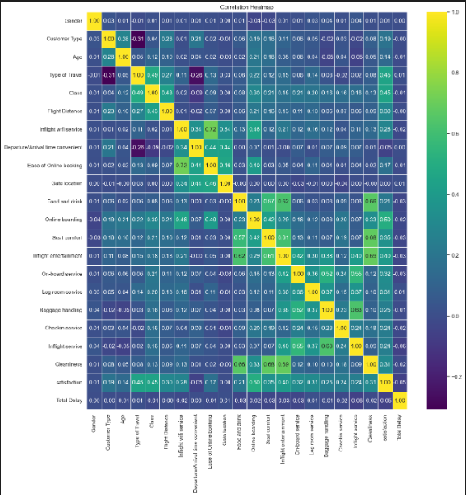
Exploration and Visualization
Correlation Heatmap
Visualized relationships between features such as service ratings, delays, and satisfaction.
Insight: In-flight service ratings and delay duration are top predictors of satisfaction.

Slide 8
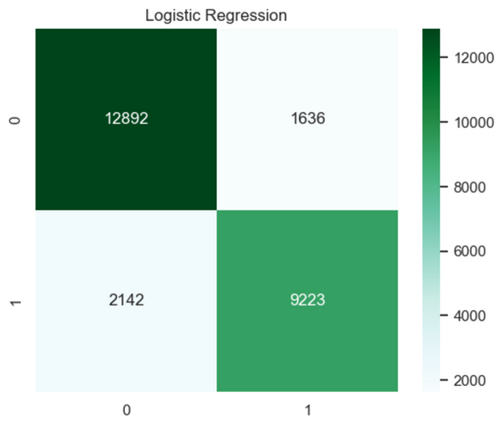
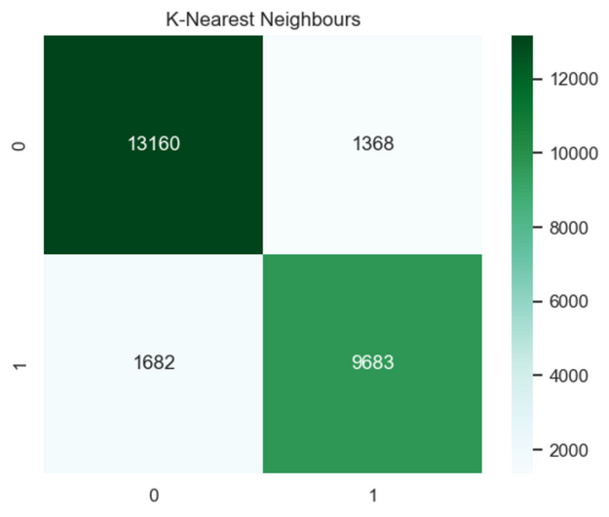
ML Modeling
Approach:
Used multiple classification models for performance comparison.
Ensured models were suitable for binary classification.
Model 1: Logistic Regression:
Selected as a simple and interpretable baseline.
Provided a starting point to evaluate more complex models.
Model 2: K-Nearest Neighbors (KNN):
Focused on grouping passengers with similar attributes.
Observed trends in localized satisfaction patterns.

Slide 9
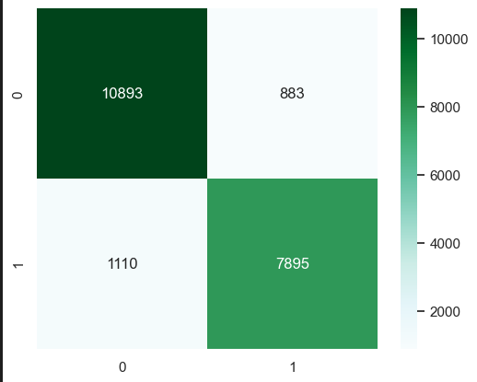
ML Modeling
Model 3: Random Forest:
Chosen for its robustness in handling non-linear relationships.
Provided feature importance to identify key factors influencing satisfaction.
Preprocessing for All Models:
Missing values were addressed systematically.
Numerical features were scaled, and categorical features were encoded.

Slide 10
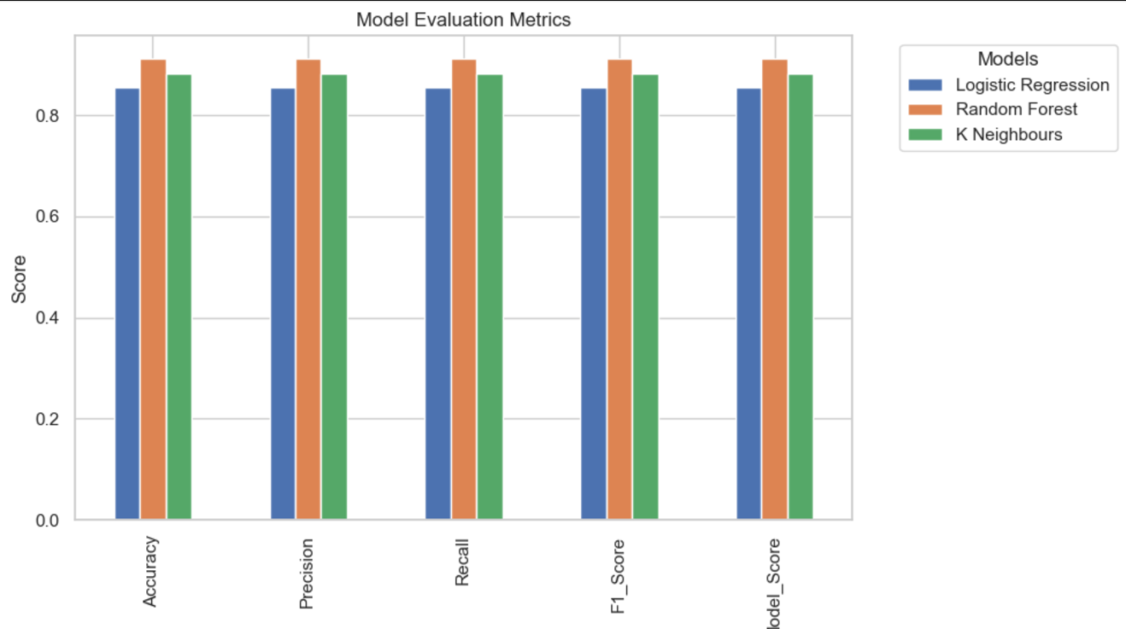
Results
Model Performance
Logistic Regression:
Provided baseline accuracy and interpretability.
K-Nearest Neighbors (KNN):
Improved accuracy by detecting localized patterns.
Random Forest:
Outperformed all models with the highest accuracy.
Accuracy Scores:
Logistic Regression: 85.9%
KNN: 88.1%
Random Forest: 90.4%

Slide 11
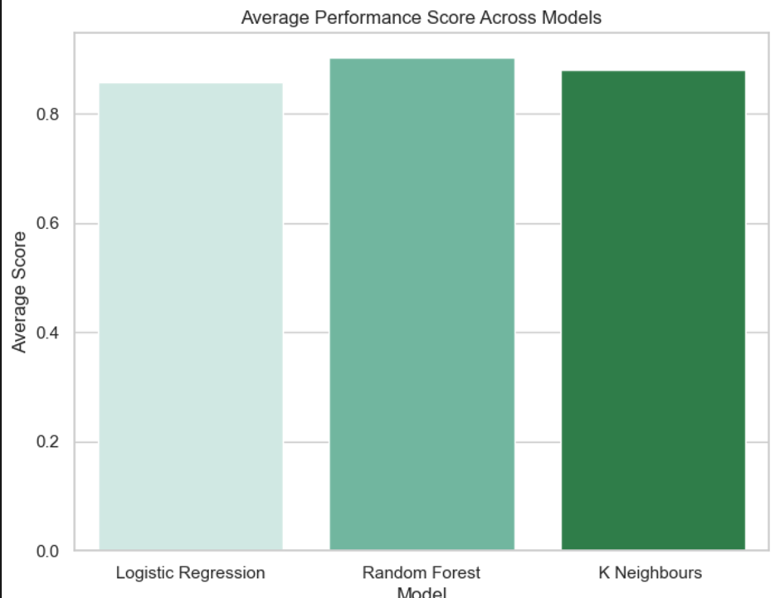
Results
Key Insights and Conclusion
Key Insights:
Top predictors: In-flight service, delays, and seat comfort.
Random Forest excelled in capturing complex relationships, ensuring reliability.
Conclusion:
Machine learning effectively predicted customer satisfaction.
Delivered actionable insights to enhance airline service quality.

